Slide 1
Indian Road Accident Analytics
What 20,000 accident records say about causes, severity, time, cities and festivals
Python • MySQL • Power BI

Slide 2
Dataset and Approach
1. Clean (Python)
20,000
Filled missing festival values, fixed date types, standardised labels, checked day/hour consistency
accident records (2022 – Apr 2025)
2. Engineer
8 cities · 7 states
Added year, month, time of day, is_festival, casualty per vehicle
24 raw columns, 29 after feature engineering
3. Analyse (MySQL)
Fatal rate by cause, JOINs with city/region table, CTEs, window functions (LAG, RANK, running total), festival vs normal
0
4. Visualise (Power BI)
duplicates; no outliers found
Interactive dashboard with KPI cards and slicers

Slide 3
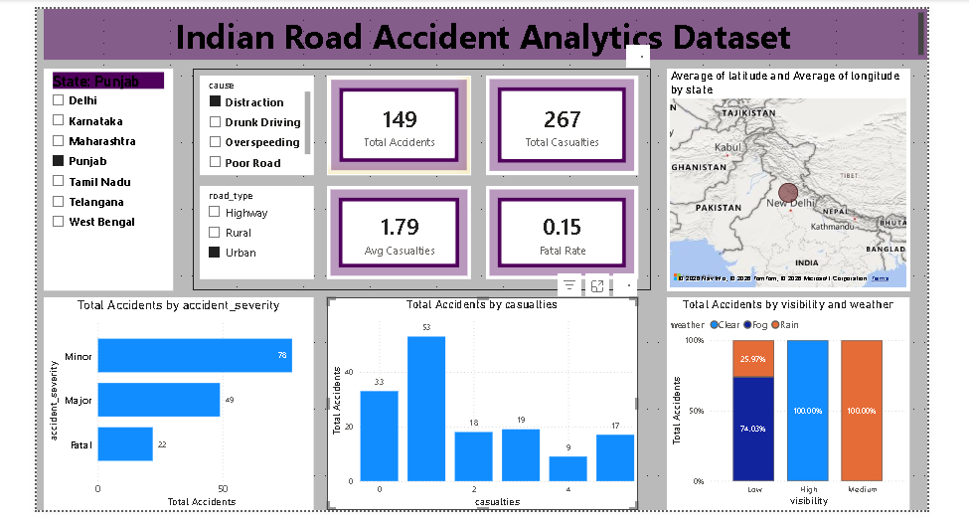
Power BI Dashboard
KPI cards
Total Accidents · Total Casualties · Avg Casualties · Fatal Rate
Visuals
State map · Accidents by severity · Accidents by casualties · Visibility by weather
Slicers
State · Cause · Road type

Slide 4
Severity and Causes
55.1%
Minor accidents
29.9%
Major accidents
14.9%
Fatal; avg 3.0 casualties vs 1.5
Cause matters only slightly (chi-square p = 0.045); Distraction is the lowest.

Slide 5
When and Where: Evenly Spread
Accident counts show no significant pattern by hour, weekday, month or city.
p = 0.47
p = 0.10
p = 0.16
p = 0.08
Hour of day
Day of week
Month
City counts
Conditions matter more: average risk score
0.59
0.49
0.24
0.60 vs 0.38
Fog
Rain
Clear
Peak vs non-peak hour

Slide 6
Festivals and Risk
2.04 vs 1.73
Avg casualties: festival vs normal days (p = 0.03)
0.56 vs 0.44
Avg risk score: festival vs normal days
Only 115 festival accidents (Holi: 38), so treat the Holi spike as a signal to monitor, not a proven effect.

Slide 7
Key Takeaways
Severity
About 1 in 7 accidents is fatal (14.9%), with twice the casualties of other types.
Causes
Poor roads and drunk driving have the highest fatal rates; Distraction the lowest.
Time and place
No hour, weekday, month or city stands out; risk follows conditions, not locations.
Conditions
Fog, rain and peak hours raise risk; festivals raise casualties per accident.
Recommendations: improve road quality and drink-driving checks, add fog and rain alerts, and increase patrols around peak hours and festivals.

